Slide 1
Data Harmonization and Insights Extraction
Created by :- Omkar V. Gosavi

Slide 2
Index
The project overview and objectives.
Data wrangling and cleaning steps.
Key challenges and how they were addressed.
Insights and findings from the dataset.

Slide 3
The project overview and objectives.
Steps to workout the project:-
Load datasets into Python – Acquire data through following path. dataset1 = pd.read_excel(r'C:\Users\HP\Desktop\Project 2\dataset_1.xlsx’). Load another datasets though this way.
Inspect and explore data structures using .info() and .head(). – Through this path, you will get the info about the dataset. dataset1.info(). Here you will get the details like Column types, Count, data types etc. Similarly with remaining datasets and for head, the following path will be applied dataset1.head(). Through this path you will get first 5 rows. It is just like a header in the word file.
Merge all the datasets and get the overview like null, handling missing value by using bf function, formulas to get outlier detection.

Slide 4
Data wrangling and cleaning steps.
Steps for data wrangling :-
Merge dataset 1 & 2 through this path. –
merge_1_and_2 = pd.merge(dataset1,dataset2,on='instant',how = 'inner’)
2) Find out the null values if any in the merged datasets –
merge_1_and_2.isnull().sum()
3) If you found the null value the fill it by this formula
bfill = merge_1_and_2.fillna(method='bfill')bfill.isnull().sum()
Key challenges - We don’t know about the perfect null values so we have used the above backward fill formula to fill the empty items.

Slide 5
Insights and findings from the dataset .
We found the following :-
We found some null values in merged data sets so we filled that with the help of backward fill formula.
Perform basic statistical analysis to evaluate with help of mean, median and mode, Upper value, Lower value, Percentile of 25th, 50th, 75th, 100. Then we get the IQR of the dataset.
Perform detailed missing value analysis and outlier detection with the help of subplot and distplot formulas.
Analyze skewness of numerical columns with the help of this formula - dataset1['weathersit'].skew()
Visualize key insights using heatmaps, scatter plots, and boxplots. We will show you in the next slide.

Slide 6
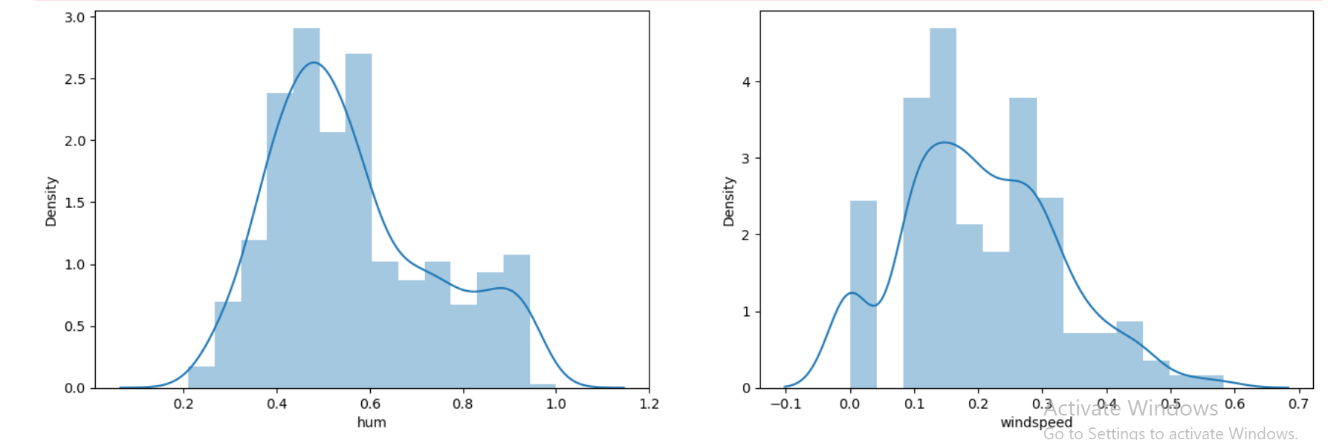
Visualization through graphs. .

Slide 7
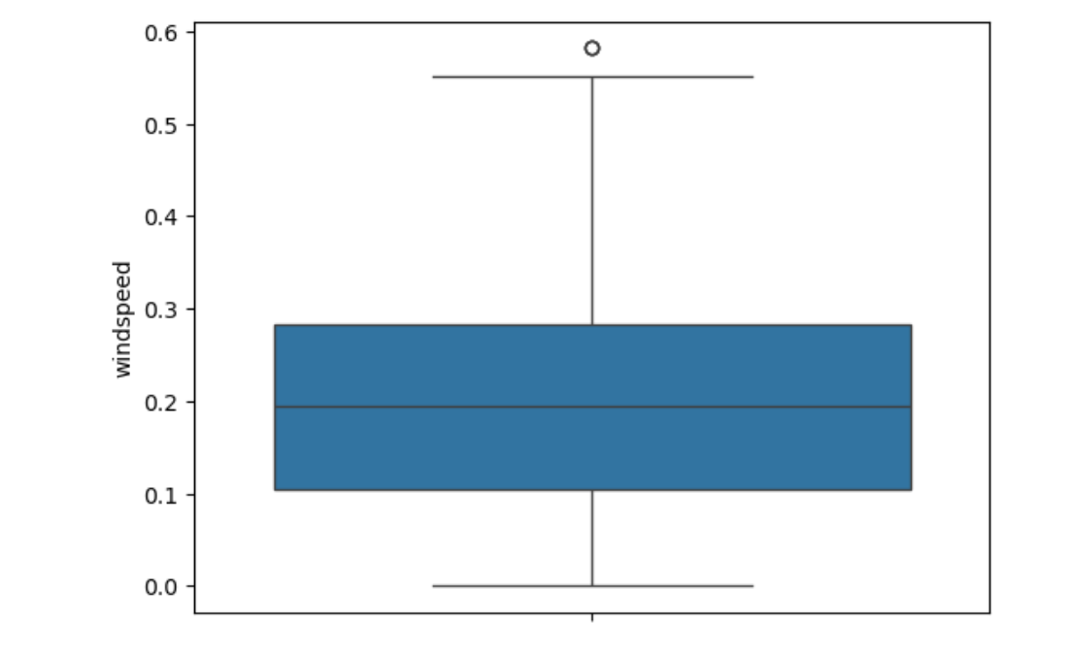
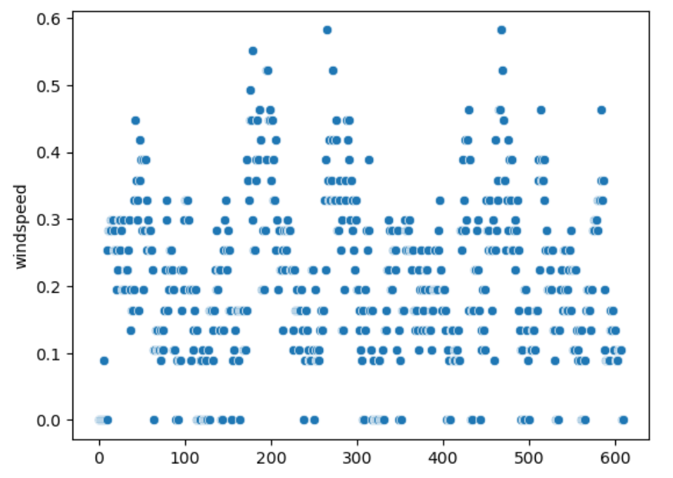
Visualization through graphs. .

Slide 8
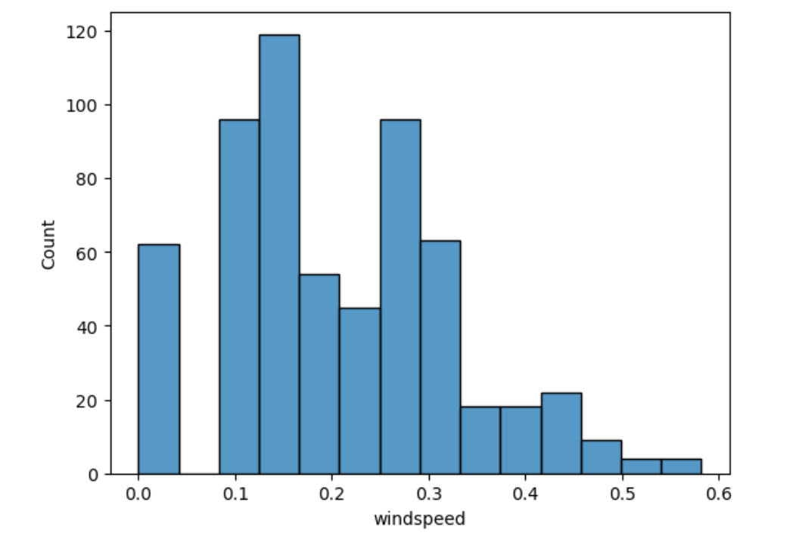
Visualization through graphs. .

Slide 9
Thanks for watching…..

